Slide 1

HYPERSPECTRAL IMAGE CLASSIFICATION USING DEEPLEARNING
Under the Enviable and Esteemed Guidence of
Dr. B. SaiChandana, _{M.Tech, PhD}
Associate Professor, Department of CSE
by
Kalpana Patnala 17481A05D6
Amani Tammana 17481A05H2
Premdeep Ganjala 18485A0518
Kumar Vallabhapurapu 18485A0526

Slide 2
ABSTRACT
Remote sensing is a technology which gathers information of object on earth in form of an image without any contact using satellites. The satellites will generate information with more spatial and spectral resolution, providing new opportunities in remote sensing image classification techniques. The hyperspectral data contains hundreds of narrow bands representing the same scene on earth, with each pixel has a continuous reflectance spectrum.
To analyze hyperspectral data, methods which are developed for multispectral images are used. These methods analyze the hyperspectral data with few bands, usually less than seven and are randomly selected. Hyperspectral data contain hundreds of narrow bands, in which some bands may contain more information, while other bands may contain less discriminative information.
In this project, three algorithms are used for hyperspectral image classifications. Principal Component Analysis is used for dimensionality reduction, to remove the redundancy between bands. Second Empirical mode decomposition method is used to extract the features from the selected bands. Finally, Convolution Neural Network is used for classification. The experimental results compared with other traditional classification methods such as SVM, EMD-SVM etc.

Slide 3
INTRODUCTION
In recent years, people have only begun to obtain hyperspectral remote sensing images with high spatial resolution and high spectral resolution. Beacause hyperspectral images have strong resolving power for fine spectra, they have a wide range of applications in military, medical field etc. It is used to image in the ultraviolet, visible, near-infrared, and mid infrared regions of electro magnetic waves.
The hyperspectral data contains hundreds of narrow bands representing the same scene on earth, with each pixel has a continuous reflectance spectrum.
To analyze hyperspectral data, methods which are developed for multispectral images are used. These methods analyze the hyperspectral data with few bands, usually less than seven and are randomly selected. Hyperspectral data contain hundreds of narrow bands, in which some bands may contain more information, while other bands may contain less discriminative information.

Slide 4
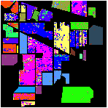

EXISTING SYSTEM
Hyperspectral images are used to identify and detect the objects on the earths surface. Since classification of these images becoming difficult task, because of more number of spectral bands. Due to high dimentionality problems, In existing system, to classify these hyperspectral data a method has proposed based on the support vector machine(SVM) along with the guided image filter.
This GIF is a kind of edge-peserving smoothening filter and it can also filter out noise or texture while retaining sharp edges.
Based on this, the experimental results shows that SVM with radial basis functions will give better accuracy results compared to other kernels.

Slide 5
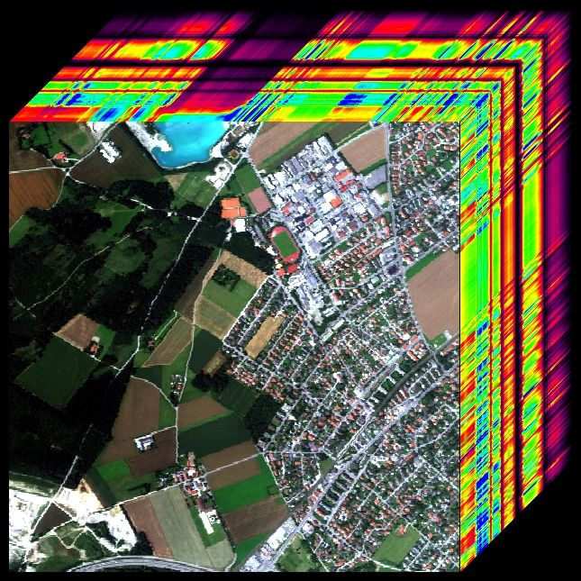
PROPOSED SYSTEM
To classify hyperspectral image, In proposed system three algorithms are used for three different processes. Algorithms used are Principle component analysis(PCA), Empherical model decompostion(EMD), Convolution Neural Network(CNN).
The Principal Component Analysis is used for dimensionality reduction, to remove the redundancy between bands. Second Empirical mode decomposition method is used to extract the features from the selected bands. Finally, Convolution Neural Network is used for classification.
Finally the obtained results of classification of hyperspecral data compared with the previous methods like Suppport Vector Machine(SVM) to get best accurate results.
Extraction of Bands

Slide 6
IMPLEMENTATION
The dataset used in the project is a hyperspectral image of an Indian pines.
The following are the steps used in implementation of hyperspectral image classification.
Collecting the dataset
Designing the process
Implementing Dimensionality Reduction
Training and Testing the model and
Predicting the model.
In this project, three algorithms are used to classify the hyperspectral image like Principal component analysis, Empherical mode decomposition, and CNN.
Initially the hyperspectral image is analysed inorder to extract the bands of an image.

Slide 7
IMPLEMENTATION
Later, To reduce the redundency between the bands of an image, pricipal component analysis(PCA) is used for the dimensionality reduction.
Then, To extract the features from the from the selected bands of an image, Emperical mode decomposition(EMD) is used.
Convolutional Neural networks will be implemented in python using the keras library.
We use keras library with the Tensorflow backend to implement the classification of an using Convolutional Neural Network(CNN).
The Convolutional Neural Network is used to classify the pixels of the Hyperspectral image.
Later, the model that is implemented will be confirmed using the predicted results of accuracy score, classification report and confusion matrix.
Finally, classification map of classifier is visualized.

Slide 8



Slide 9


